Slide 1
Structured Ops in MLIR
Compiling Loops, Libraries and DSLs
MLIR Open Design Meeting - Dec 5th 2019
Albert Cohen, Andy Davis, Nicolas Vasilache, Alex Zinenko

Slide 2
Outline
MLIR Dialects for Codegen
Structured Ops Abstraction - Buffers
Structured Ops Abstraction - Vectors
Declarative Transformations with Composable Patterns
Conclusion

Slide 3
MLIR Dialects for Codegen

Slide 4
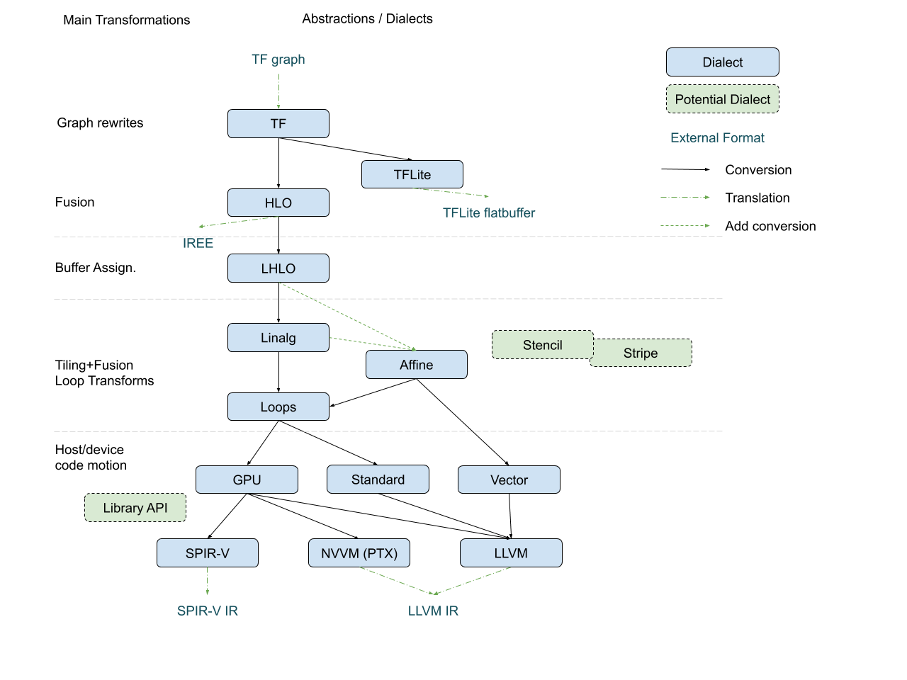
Notes:
The dialect landscape in MLIR is rather complex, so let’s look at it step by step following the lowering pipeline. You don’t need to try and understand the details of all the dialects involved. Since MLIR started as a TensorFlow project, the existing pipelines start with TensorFlow dialects. They correspond to the tools that have existed in the TensorFlow ecosystem before MLIR. For the sake of the compiler, we just consider them as an “MLIR front-end”. HLO is XLA’s High-Level optimizer format cast as a dialect.

Slide 5
Notes:
All of these dialects contain high-level operations such as convolutions and operate on tensors, which are seen as value-types in MLIR.

Slide 6
Notes:
Beyond pure representational capacity, these dialects serve to perform graph-level transformations such as operator fusion.

Slide 7
Notes:
When we exhausted the options for graph-level transformations treating tensors as values, we start looking closer into the details and open up the tensor abstraction. The late HLO dialect is similar to HLO but it operates on MLIR’s structured memory references (memrefs) and sees accesses to individual elements of a tensor.

Slide 8
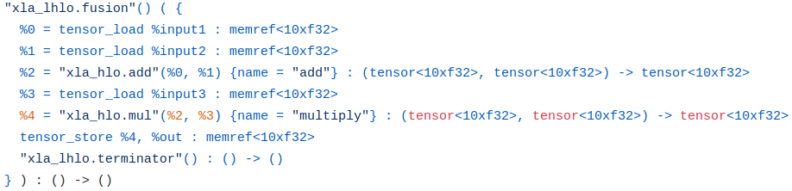
Notes:
From the first look, it seems similar. But it can actually goes from SSA value abstraction of a tensor to a memory abstraction of a memref, which is is better seen when we have to mix the two.

Slide 9
Notes:
The main role of this lowering is exactly the transition from values to buffers, a buffer assignment transformation.

Slide 10
Notes:
Once we have the buffer abstraction, we start getting interested in how the individual elements of a buffer get processed. At the same time, we may not yet want to lose the idea of what high-level operations we are performing. This spans, for example the linear algebra dialect, which defines generic computational structures for things like tensor contractions and convolutions.

Slide 11
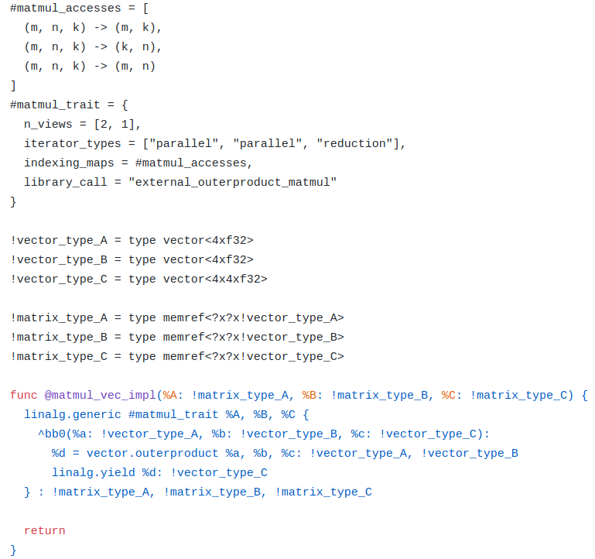
Notes:
The structures are parameterized by attributes and have a custom body of computation. This enables data layout transformations and other modifications that make use of the knowledge of the specific operation, or the mapping to existing high-performance libraries.

Slide 12
Notes:
At an even lower level, we can replace custom computational structures with more common ones like loops. Here, the lowering paths start diverging as we have two alternatives: Loops and Affine, with the only significant difference that Affine has additional constraints that make it suitable for polyhedral modeling.

Slide 13
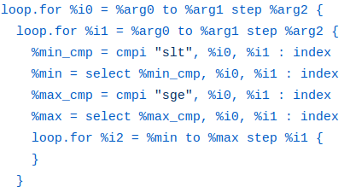

Slide 14
Notes:
The Stencil and Stripe dialects discussed before in these meetings fit roughly into the same category

Slide 15
Notes:
And the idea of loop-like structures is more about tiling and element-wise transformations.

Slide 16
Notes:
Now we are ready to go to specific targets, and the whole picture becomes more complex, diverging based on the properties of the target. We can go to the GPU dialect, which manages the device kernel abstraction, or to the Standard dialect which has LLVM-like control flow with basic blocks.

Slide 17
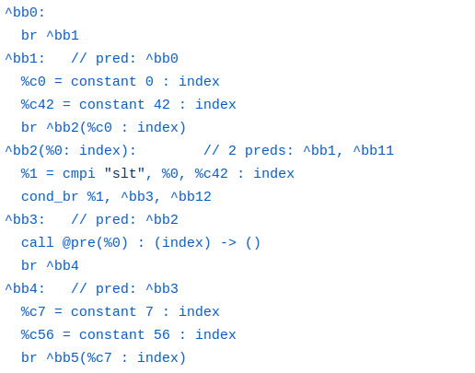
Notes:
Now we are ready to go to specific targets, and the whole picture becomes more complex, diverging based on the properties of the target. We can go to the GPU dialect, which manages the device kernel abstraction, or to the Standard dialect which has LLVM-like control flow with basic blocks.

Slide 18
Notes:
We can also go to the vector dialect which contains operations on n-dimensional vectors.

Slide 19
Notes:
With the main idea to do target adaptation and host-device motion.

Slide 22
The lowering is not so much about transformations as it is about structure.
Or rather having the right structure at the right time.

Slide 24


Slide 25
Buffer
Tensor
Implicit
Explicit
Loops
CFG

Slide 26
Buffer
Tensor
Implicit
Explicit
Loops
CFG

Slide 27
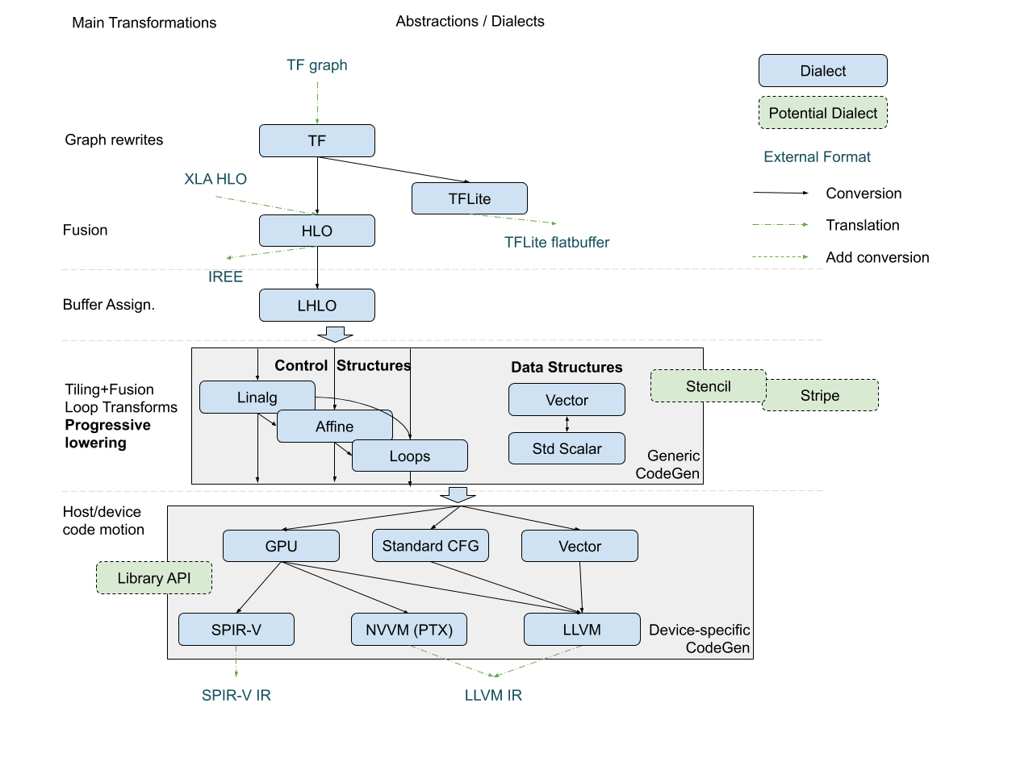

Slide 29
Structured Ops Rationale

Slide 30
Philosophy: Transformations First
Transformations are the difference between
a compiler (-O0)
an optimizing compiler (-Ox)
Transformations are applied statically, they need some static information

Slide 31
Observation: Useful IR Entities That Bring Structure
Structured Types
N-D vectors, memref, strided memref, memref with layout
Dynamic evolution (ragged and sparse memref)
Less regular but structured types: trees, concurrent hash maps, ...

Slide 32
Observation: Useful IR Entities That Bring Structure
Structured Types
N-D vectors, memref, strided memref, memref with layout
Dynamic evolution (ragged and sparse memref)
Less regular but structured types: trees, concurrent hash maps, ...
Structured Iterators
Defined by data, not just a bag of control-flow
Properties that enable transformations (parallel, reduction, tilable etc)

Slide 33
Observation: Useful IR Entities That Bring Structure
Structured Types
N-D vectors, memref, strided memref, memref with layout
Dynamic evolution (ragged and sparse memref)
Less regular but structured types: trees, concurrent hash maps, ...
Structured Iterators
Defined by data, not just a bag of control-flow
Properties that enable transformations (parallel, reduction, tilable etc)
Structured Ops combine 3 “things”
Tie structured types and structured iterators in a coherent unit
Properties to simplify analyses and transformations
High-level correspondence with library calls

Slide 34
Structured Ops Abstraction - Buffers

Slide 35
Structured Ops At The Buffer Level
Encode key properties in the type system, consistent with DSL philosophy
#matmul_accesses = [
(m, n, k) -> (m, k),
(m, n, k) -> (k, n),
(m, n, k) -> (m, n)
]
#matmul_trait = {
args_in = 2, args_out = 1,
iterator_types = [parallel, parallel, reduction],
indexing = #matmul_accesses,
library_call = "matmul_f32"
}
"s.op" #matmul_trait (%A, %B, %C) {
^bb0(%a: f32, %b: f32, %c: f32):
%d = mulf %a, %b: f32
%e = addf %c, %d: f32
"s.yield" %e: f32
} : memref<?x?xf32>, memref<?x?xf32>, memref<?x?xf32>

Slide 36
Structured Ops At The Buffer Level
Key property: Input and Output Buffer Operands + Types
#matmul_accesses = [
(m, n, k) -> (m, k),
(m, n, k) -> (k, n),
(m, n, k) -> (m, n)
]
#matmul_trait = {
args_in = 2, args_out = 1,
iterator_types = [parallel, parallel, reduction],
indexing = #matmul_accesses,
library_call = "matmul_f32"
}
"s.op" #matmul_trait (%A, %B, %C) {
^bb0(%a: f32, %b: f32, %c: f32):
%d = mulf %a, %b: f32
%e = addf %c, %d: f32
"s.yield" %e: f32
} : memref<?x?xf32>, memref<?x?xf32>, memref<?x?xf32>
for … {
…
for … {
%a = "load" %A[..., ...]: memref<?x?xf32>
%b = "load" %B[..., ...]: memref<?x?xf32>
%c = "load" %C[..., ...]: memref<?x?xf32>
%cc = "compute"(%a, %b, %c): (f32, f32, f32) -> (f32) // compute arg types match element types
"store" %cc, %C[..., ...]: memref<?x?xf32>
} … }

Slide 37
Structured Ops At The Buffer Level
Key property: Input and Output Buffer Operands + Types
#matmul_accesses = [
(m, n, k) -> (m, k),
(m, n, k) -> (k, n),
(m, n, k) -> (m, n)
]
#matmul_trait = {
args_in = 2, args_out = 1,
iterator_types = [parallel, parallel, reduction],
indexing = #matmul_accesses,
library_call = "matmul_f32"
}
"s.op" #matmul_trait (%A, %B, %C) {
^bb0(%a: f32, %b: f32, %c: f32):
%d = mulf %a, %b: f32
%e = addf %c, %d: f32
"s.yield" %e: f32
} : memref<?x?xf32>, memref<?x?xf32>, memref<?x?xf32>
for … {
…
for … {
%a = "load" %A[..., ...]: memref<?x?xf32>
%b = "load" %B[..., ...]: memref<?x?xf32>
%c = "load" %C[..., ...]: memref<?x?xf32>
%cc = "compute"(%a, %b, %c): (f32, f32, f32) -> (f32) // compute arg types match element types
"store" %cc, %C[..., ...]: memref<?x?xf32>
} … }

Slide 38
Structured Ops At The Buffer Level
Key property: Input and Output Buffer Operands + Types
#matmul_accesses = [
(m, n, k) -> (m, k),
(m, n, k) -> (k, n),
(m, n, k) -> (m, n)
]
#matmul_trait = {
args_in = 2, args_out = 1,
iterator_types = [parallel, parallel, reduction],
indexing = #matmul_accesses,
library_call = "matmul_f32"
}
"s.op" #matmul_trait (%A, %B, %C) {
^bb0(%a: f32, %b: f32, %c: f32):
%d = mulf %a, %b: f32
%e = addf %c, %d: f32
"s.yield" %e: f32
} : memref<?x?xf32>, memref<?x?xf32>, memref<?x?xf32>
for … {
…
for … {
%a = "load" %A[..., ...]: memref<?x?xf32>
%b = "load" %B[..., ...]: memref<?x?xf32>
%c = "load" %C[..., ...]: memref<?x?xf32>
%cc = "compute"(%a, %b, %c): (f32, f32, f32) -> (f32) // compute arg types match element types
"store" %cc, %C[..., ...]: memref<?x?xf32>
} … }

Slide 39
Structured Ops At The Buffer Level
Key property: Input and Output Buffer Operands + Types
#matmul_accesses = [
(m, n, k) -> (m, k),
(m, n, k) -> (k, n),
(m, n, k) -> (m, n)
]
#matmul_trait = {
args_in = 2, args_out = 1,
iterator_types = [parallel, parallel, reduction],
indexing = #matmul_accesses,
library_call = "matmul_f32"
}
"s.op" #matmul_trait (%A, %B, %C) {
^bb0(%a: f32, %b: f32, %c: f32):
%d = mulf %a, %b: f32
%e = addf %c, %d: f32
"s.yield" %e: f32
} : memref<?x?xf32>, memref<?x?xf32>, memref<?x?xf32>
for … {
…
for … {
%a = "load" %A[..., ...]: memref<?x?xf32>
%b = "load" %B[..., ...]: memref<?x?xf32>
%c = "load" %C[..., ...]: memref<?x?xf32>
%cc = "compute"(%a, %b, %c): (f32, f32, f32) -> (f32) // compute arg types match element types
"store" %cc, %C[..., ...]: memref<?x?xf32>
} … }

Slide 40
Structured Ops At The Buffer Level
Key property: Domain traversal (Reversible mappings from iterations to data type)
#matmul_accesses = [
(m, n, k) -> (m, k),
(m, n, k) -> (k, n),
(m, n, k) -> (m, n)
]
#matmul_trait = {
args_in = 2, args_out = 1,
iterator_types = [parallel, parallel, reduction],
indexing = #matmul_accesses,
library_call = "matmul_f32"
}
"s.op" #matmul_trait (%A, %B, %C) {
^bb0(%a: f32, %b: f32, %c: f32):
%d = mulf %a, %b: f32
%e = addf %c, %d: f32
"s.yield" %e: f32
} : memref<?x?xf32>, memref<?x?xf32>, memref<?x?xf32>
%M = "dim" %A, 0: index
%K = "dim" %A, q: index
%KK = "dim" %B, 0: index
%N = "dim" %B, 1: index
%MM = "dim" %C, 0: index
%NN = "dim" %C, 1: index
%eq = "eq" %M, %MM: i1 // inferred iteration space is consistent with data
"assert" %eq: (i1) -> ()
...
for %m = 0 to %M {
for %n = 0 to %N {
for %k = 0 to %K {
%a = "load" %A[%m, %k]: memref<?x?xf32>
%b = "load" %B[%k, %n]: memref<?x?xf32>
%c = "load" %C[%m, %n]: memref<?x?xf32>
%cc = "compute"(%a, %b, %c): (f32, f32, f32) -> (f32) // compute arg types match element type
"store" %cc, %C[%m, %n]: memref<?x?xf32>
}}}

Slide 41
Structured Ops At The Buffer Level
Key property: Domain traversal (Reversible mappings from iterations to data type)
#matmul_accesses = [
(m, n, k) -> (m, k),
(m, n, k) -> (k, n),
(m, n, k) -> (m, n)
]
#matmul_trait = {
args_in = 2, args_out = 1,
iterator_types = [parallel, parallel, reduction],
indexing = #matmul_accesses,
library_call = "matmul_f32"
}
"s.op" #matmul_trait (%A, %B, %C) {
^bb0(%a: f32, %b: f32, %c: f32):
%d = mulf %a, %b: f32
%e = addf %c, %d: f32
"s.yield" %e: f32
} : memref<?x?xf32>, memref<?x?xf32>, memref<?x?xf32>
%M = "dim" %A, 0: index
%K = "dim" %A, q: index
%KK = "dim" %B, 0: index
%N = "dim" %B, 1: index
%MM = "dim" %C, 0: index
%NN = "dim" %C, 1: index
%eq = "eq" %M, %MM: i1 // inferred iteration space is consistent with data
"assert" %eq: (i1) -> ()
...
for %m = 0 to %M {
for %n = 0 to %N {
for %k = 0 to %K {
%a = "load" %A[%m, %k]: memref<?x?xf32>
%b = "load" %B[%k, %n]: memref<?x?xf32>
%c = "load" %C[%m, %n]: memref<?x?xf32>
%cc = "compute"(%a, %b, %c): (f32, f32, f32) -> (f32) // compute arg types match element type
"store" %cc, %C[%m, %n]: memref<?x?xf32>
}}}

Slide 42
Structured Ops At The Buffer Level
Key property: Domain traversal (Reversible mappings from iterations to data type)
#matmul_accesses = [
(m, n, k) -> (m, k),
(m, n, k) -> (k, n),
(m, n, k) -> (m, n)
]
#matmul_trait = {
args_in = 2, args_out = 1,
iterator_types = [parallel, parallel, reduction],
indexing = #matmul_accesses,
library_call = "matmul_f32"
}
"s.op" #matmul_trait (%A, %B, %C) {
^bb0(%a: f32, %b: f32, %c: f32):
%d = mulf %a, %b: f32
%e = addf %c, %d: f32
"s.yield" %e: f32
} : memref<?x?xf32>, memref<?x?xf32>, memref<?x?xf32>
%M = "dim" %A, 0: index
%K = "dim" %A, q: index
%KK = "dim" %B, 0: index
%N = "dim" %B, 1: index
%MM = "dim" %C, 0: index
%NN = "dim" %C, 1: index
%eq = "eq" %M, %MM: i1 // inferred iteration space is consistent with data
"assert" %eq: (i1) -> ()
...
for %m = 0 to %M {
for %n = 0 to %N {
for %k = 0 to %K {
%a = "load" %A[%m, %k]: memref<?x?xf32>
%b = "load" %B[%k, %n]: memref<?x?xf32>
%c = "load" %C[%m, %n]: memref<?x?xf32>
%cc = "compute"(%a, %b, %c): (f32, f32, f32) -> (f32) // compute arg types match element type
"store" %cc, %C[%m, %n]: memref<?x?xf32>
}}}

Slide 43
Structured Ops At The Buffer Level
Key property: Custom computation with region (or MLIR function)
#matmul_accesses = [
(m, n, k) -> (m, k),
(m, n, k) -> (k, n),
(m, n, k) -> (m, n)
]
#matmul_trait = {
args_in = 2, args_out = 1,
iterator_types = [parallel, parallel, reduction],
indexing = #matmul_accesses,
library_call = "matmul_f32"
}
"s.op" #matmul_trait (%A, %B, %C) {
^bb0(%a: f32, %b: f32, %c: f32):
%d = mulf %a, %b: f32
%e = addf %c, %d: f32
"s.yield" %e: f32
} : memref<?x?xf32>, memref<?x?xf32>, memref<?x?xf32>
...
for %m = 0 to %M {
for %n = 0 to %N {
for %k = 0 to %K {
%a = "load" %A[%m, %k]: memref<?x?xf32>
%b = "load" %B[%k, %n]: memref<?x?xf32>
%c = "load" %C[%m, %n]: memref<?x?xf32>
%d = mulf %a, %b: f32 // region body inlined
%e = addf %d, %c: f32
"store" %e, %C[%m, %n]: memref<?x?xf32>
}}}

Slide 44
Structured Ops At The Buffer Level
Key property: Implicit iterator types (future: explicit mapping to virtual processor id)
#matmul_accesses = [
(m, n, k) -> (m, k),
(m, n, k) -> (k, n),
(m, n, k) -> (m, n)
]
#matmul_trait = {
args_in = 2, args_out = 1,
iterator_types = [parallel, parallel, reduction],
indexing = #matmul_accesses,
library_call = "matmul_f32"
}
"s.op" #matmul_trait (%A, %B, %C) {
^bb0(%a: f32, %b: f32, %c: f32):
%d = mulf %a, %b: f32
%e = addf %c, %d: f32
"s.yield" %e: f32
} : memref<?x?xf32>, memref<?x?xf32>, memref<?x?xf32>
// iterator_types used for transformations,
// carry semantic information about dependences

Slide 45
Structured Ops At The Buffer Level
Key property: May correspond to an external library call
#matmul_accesses = [
(m, n, k) -> (m, k),
(m, n, k) -> (k, n),
(m, n, k) -> (m, n)
]
#matmul_trait = {
args_in = 2, args_out = 1,
iterator_types = [parallel, parallel, reduction],
indexing = #matmul_accesses,
library_call = "matmul_f32"
}
"s.op" #matmul_trait (%A, %B, %C) {
^bb0(%a: f32, %b: f32, %c: f32):
%d = mulf %a, %b: f32
%e = addf %c, %d: f32
"s.yield" %e: f32
} : memref<?x?xf32>, memref<?x?xf32>, memref<?x?xf32>
func @matmul_f32 (memref<?x?xf32>, memref<?x?xf32>, memref<?x?xf32>) -> ()
call @matmul_f32 (%A, %B, %C): (memref<?x?xf32>, memref<?x?xf32>, memref<?x?xf32>) -> ()
func @matmul_f32 (!llvm<"{ float*, i64, [2 x i64], [3 x i64] }*">,
!llvm<"{ float*, i64, [2 x i64], [3 x i64] }*">,
!llvm<"{ float*, i64, [2 x i64], [3 x i64] }*">) -> ()
llvm.call @matmul_f32 (%A, %B, %C): (!llvm<"{ float*, i64, [2 x i64], [3 x i64] }*">...) -> ()

Slide 46
Structured Ops At The Buffer Level
For more properties see the backup slides.
#matmul_accesses = [
(m, n, k) -> (m, k),
(m, n, k) -> (k, n),
(m, n, k) -> (m, n)
]
#matmul_trait = {
args_in = 1, args_out = 1,
iterator_types = [parallel, parallel, reduction],
indexing = #matmul_accesses,
library_call = "matmul_f32"
}
"s.op" #matmul_trait (%A, %B, %C) {
^bb0(%a: f32, %b: f32, %c: f32):
%d = mulf %a, %b: f32
%e = addf %c, %d: f32
"s.yield" %e: f32
} : memref<?x?xf32>, memref<?x?xf32>, memref<?x?xf32>
%M = "dim" %A, 0: index
%K = "dim" %A, q: index
%KK = "dim" %B, 0: index
%N = "dim" %B, 1: index
%MM = "dim" %C, 0: index
%NN = "dim" %C, 1: index
%eq = "eq" %M, %MM: i1 // inferred iteration space is consistent with data
"assert" %eq: (i1) -> ()
...
for %m = 0 to %M {
for %n = 0 to %N {
for %k = 0 to %K {
%a = "load" %A[%m, %k]: memref<?x?xf32>
%b = "load" %B[%k, %n]: memref<?x?xf32>
%c = "load" %C[%m, %n]: memref<?x?xf32>
%cc = "compute"(%a, %b, %c): (f32, f32, f32) -> (f32) // compute arg types match element type
"store" %cc, %C[%m, %n]: memref<?x?xf32>
}}}

Slide 47
Recap: Structured Ops At The Buffer Level
Encode key properties in the type system, consistent with DSL philosophy
#matmul_accesses = [
(m, n, k) -> (m, k),
(m, n, k) -> (k, n),
(m, n, k) -> (m, n)
]
#matmul_trait = {
args_in = 2, args_out = 1,
iterator_types = [parallel, parallel, reduction],
indexing = #matmul_accesses,
library_call = "matmul_f32"
}
"s.op" #matmul_trait (%A, %B, %C) {
^bb0(%a: f32, %b: f32, %c: f32):
%d = mulf %a, %b: f32
%e = addf %c, %d: f32
"s.yield" %e: f32
} : memref<?x?xf32>, memref<?x?xf32>, memref<?x?xf32>
Automatically Sugar Into (NYI)
s.matmul (%A, %B, %C) : memref<?x?xf32>, memref<?x?xf32>, memref<?x?xf32>

Slide 48
Structured Ops Abstraction - Vectors

Slide 49
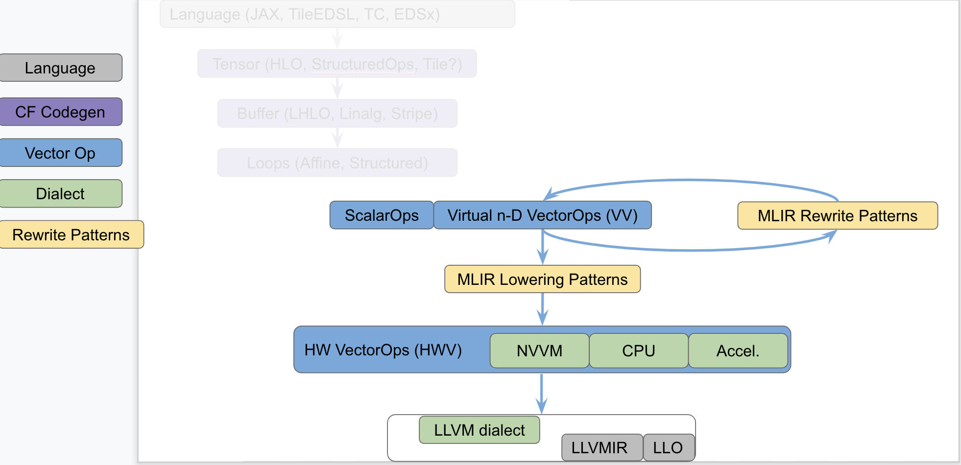
Positioning of Vector Dialects

Slide 50
Structured Ops At The Vector Level
Encode key properties in the type system, consistent with DSL philosophy
#contraction_accesses = [
(b0, f0, f1, c0, c1) -> (c0, b0, c1, f0),
(b0, f0, f1, c0, c1) -> (b0, c1, c0, f1),
(b0, f0, f1, c0, c1) -> (b0, f0, f1)
]
#contraction_trait = {
indexing_maps = #contraction_accesses,
iterator_types = [parallel, parallel, parallel, reduction, reduction]
}
%0 = vector.contract #contraction_trait %lhs, %rhs, %acc
: vector<7x8x16x15xf32>, vector<8x16x7x5xf32> into vector<8x15x5xf32>

Slide 51
Structured Ops At The Vector Level
Encode key properties in the type system, consistent with DSL philosophy
#contraction_accesses = [
(b0, f0, f1, c0, c1) -> (c0, b0, c1, f0),
(b0, f0, f1, c0, c1) -> (b0, c1, c0, f1),
(b0, f0, f1, c0, c1) -> (b0, f0, f1)
]
#contraction_trait = {
indexing_maps = #contraction_accesses,
iterator_types = [parallel, parallel, parallel, reduction, reduction]
}
%0 = vector.contract #contraction_trait0 %lhs, %rhs, %acc
: vector<7x8x16x15xf32>, vector<8x16x7x5xf32> into vector<8x15x5xf32>
Structure
Reduction dimensions known
enables selective unrolling
Reduction dimensions separate (e.g. conv spatial dimensions)
avoids reshape

Slide 52
Structured Ops At The Vector Level
Encode key properties in the type system, consistent with DSL philosophy
#contraction_accesses = [
(b0, f0, f1, c0, c1) -> (c0, b0, c1, f0),
(b0, f0, f1, c0, c1) -> (b0, c1, c0, f1),
(b0, f0, f1, c0, c1) -> (b0, f0, f1)
]
#contraction_trait = {
indexing_maps = #contraction_accesses,
iterator_types = [parallel, parallel, parallel, reduction, reduction]
}
%0 = vector.contract #contraction_trait0 %lhs, %rhs, %acc
: vector<7x8x16x15xf32>, vector<8x16x7x5xf32> into vector<8x15x5xf32>
Structure
Reduction dimensions known
enables selective unrolling
Reduction dimensions separate (e.g. conv spatial dimensions)
avoids reshape
Operates on large vector aggregates (e.g. multiples of HW vector size).
Aggregates multiple reduction dimension iterations
enables unroll and jam, unroll and pack

Slide 53
Declarative Transformations with
Composable Patterns

Slide 54
Structured Ops Transformations
Structured Ops allow the following composable transformations:
Parametric Tiling
Promotion to Temporary Buffer
Producer-Consumer Fusion
Mapping to Parallel HW
Rewrite as Loop around finer-grained structured op
Rewrite in Vector Form
Call an HPC library (e.g. cuDNN, cuB, cuTLASS, MKL-DNN, BLIS, swizzle inventor)
Lower to Affine
Lower to LLVM
Unroll to smaller vector form
Vector rewrite patterns

Slide 55
How Are Structured Ops Transformations Composable?
Structured Ops provide a natural anchor point for pattern matching and rewriting
Composes with transformations
tiling produces loops + structured ops
mapping produces loops + structured ops
fusion produces imperfectly nested loops + structured ops
Structure
no need for complex matching rules on non-local pieces of IR
Until we decide to lower out of structured ops
→ Expose composable building blocks to define an optimization strategy: semi-automatic “schedule” like Halide, or fully automatic heuristic

Slide 56
Declarative Transformations (1) Multi-level Tiling
Match s.matmul (any type)
Capture op and arguments by name
Filter ops not marked as "L3"
def : Pat<(MatmulOp:$op $A, $B, $C), (Tile<[2000, 3000, 4000], "L3"> $op), [(Constraint<Or<[HasNoMarker, HasMarker<"MEM">]>> $op)]>;
def : Pat<(MatmulOp:$op $A, $B, $C), (Tile<[200, 300, 400], "L2"> $op), [(Constraint<HasMarker<"L3">> $op)]>;
def : Pat<(MatmulOp:$op $A, $B, $C), (Tile<[20, 30, 40], "L1"> $op), [(Constraint<HasMarker<"L2">> $op)]>;
Tile by “sizes” and mark as tiled for "L1"

Slide 57
Transformations: Declarative Multi-level Tiling
def : Pat<(MatmulOp:$op $A, $B, $C), (Tile<[2000, 3000, 4000], "L3"> $op), [(Constraint<Or<[HasNoMarker, HasMarker<"MEM">]>> $op)]>;
def : Pat<(MatmulOp:$op $A, $B, $C), (Tile<[200, 300, 400], "L2"> $op), [(Constraint<HasMarker<"L3">> $op)]>;
def : Pat<(MatmulOp:$op $A, $B, $C), (Tile<[20, 30, 40], "L1"> $op), [(Constraint<HasMarker<"L2">> $op)]>;
s.matmul (%A, %B, %C) : memref<?x?xf32, offset: ?, strides: [?, 1]> ...
Apply Tile<[2000, 3000, 4000], "L3">

Slide 58
Transformations (1) Declarative Multi-level Tiling
def : Pat<(MatmulOp:$op $A, $B, $C), (Tile<[2000, 3000, 4000], "L3"> $op), [(Constraint<Or<[HasNoMarker, HasMarker<"MEM">]>> $op)]>;
def : Pat<(MatmulOp:$op $A, $B, $C), (Tile<[200, 300, 400], "L2"> $op), [(Constraint<HasMarker<"L3">> $op)]>;
def : Pat<(MatmulOp:$op $A, $B, $C), (Tile<[20, 30, 40], "L1"> $op), [(Constraint<HasMarker<"L2">> $op)]>;
Apply Tile<[2000, 3000, 4000], "L3">
...
for %i = %c0 to %6 step %c2000 {
for %k = %c0_0 to %7 step %c3000 {
for %k = %c0_1 to %8 step %c4000 {
%9 = affine.apply (d0) -> (d0 + 2000)(%i)
...
%16 = s.subview %A[%12, %13, %c1, %14, %15, %c1] : memref<?x?xf32, (d0, d1)[s0, s1] -> (d0 * s1 + s0 + d1)>
...
%21 = s.subview %B[%17, %18, %c1, %19, %20, %c1] : memref<?x?xf32, (d0, d1)[s0, s1] -> (d0 * s1 + s0 + d1)>
...
%26 = s.subview %C[%22, %23, %c1, %24, %25, %c1] : memref<?x?xf32, (d0, d1)[s0, s1] -> (d0 * s1 + s0 + d1)>
s.matmul (%16, %21, %26) {__internal__ = "L3"} : memref<?x?xf32, (d0, d1)[s0, s1] -> (d0 * s1 + s0 + d1)>, ...
Apply Tile<[200, 300, 400], "L2">

Slide 59
Transformations (1) Declarative Multi-level Tiling
def : Pat<(MatmulOp:$op $A, $B, $C), (Tile<[2000, 3000, 4000], "L3"> $op), [(Constraint<Or<[HasNoMarker, HasMarker<"MEM">]>> $op)]>;
def : Pat<(MatmulOp:$op $A, $B, $C), (Tile<[200, 300, 400], "L2"> $op), [(Constraint<HasMarker<"L3">> $op)]>;
def : Pat<(MatmulOp:$op $A, $B, $C), (Tile<[20, 30, 40], "L1"> $op), [(Constraint<HasMarker<"L2">> $op)]>;
Apply Tile<[200, 300, 400], "L2">
...
for %i = %c0 to %0 step %c2000 {
for %j = %c0 to %2 step %c3000 {
for %k = %c0 to %1 step %c4000 {
%3 = affine.apply (d0) -> (d0)(%i)
...
%7 = s.subview %A[%3, %4, %c1, %5, %6, %c1] : memref<?x?xf32, (d0, d1)[s0, s1] -> (d0 * s1 + s0 + d1)>
...
%12 = s.subview %B[%8, %9, %c1, %10, %11, %c1] : memref<?x?xf32, (d0, d1)[s0, s1] -> (d0 * s1 + s0 + d1)>
...
%17 = s.subview %C[%13, %14, %c1, %15, %16, %c1] : memref<?x?xf32, (d0, d1)[s0, s1] -> (d0 * s1 + s0 + d1)>
...
for %ii = %c0_0 to %24 step %c200 {
for %jj = %c0_1 to %25 step %c300 {
for %kk = %c0_2 to %26 step %c400 {
%27 = affine.apply (d0) -> (d0 + 200)(%ii)
...
%34 = s.subview %7[%30, %31, %c1, %32, %33, %c1] : memref<?x?xf32, (d0, d1)[s0, s1] -> (d0 * s1 + s0 + d1)>
...
%39 = s.subview %12[%35, %36, %c1, %37, %38, %c1] : memref<?x?xf32, (d0, d1)[s0, s1] -> (d0 * s1 + s0 + d1)>
...
%44 = s.subview %17[%40, %41, %c1, %42, %43, %c1] : memref<?x?xf32, (d0, d1)[s0, s1] -> (d0 * s1 + s0 + d1)>
s.matmul (%34, %39, %44) {__internal_linalg_transform__ = "L2"} : memref<?x?xf32, (d0, d1)[s0, s1] -> (d0 * s1 + s0 + d1)> ...
Apply Tile<[20, 30, 40], "L1">

Slide 60
Transformations (1) Declarative Multi-level Tiling
def : Pat<(MatmulOp:$op $A, $B, $C), (Tile<[2000, 3000, 4000], "L3"> $op), [(Constraint<Or<[HasNoMarker, HasMarker<"MEM">]>> $op)]>;
def : Pat<(MatmulOp:$op $A, $B, $C), (Tile<[200, 300, 400], "L2"> $op), [(Constraint<HasMarker<"L3">> $op)]>;
def : Pat<(MatmulOp:$op $A, $B, $C), (Tile<[20, 30, 40], "L1"> $op), [(Constraint<HasMarker<"L2">> $op)]>;
Apply Tile<[20, 30, 40], "L1">
...
for %i = %c0 to %0 step %c2000 {
for %j = %c0 to %2 step %c3000 {
for %k = %c0 to %1 step %c4000 {
%3 = affine.apply (d0) -> (d0 + 2000)(%i)
...
%11 = s.subview %C[%D, %9, %c1, %E, %10, %c1] : memref<?x?xf32, (d0, d1)[s0, s1] -> (d0 * s1 + s0 + d1)>
...
for %arg6 = %c0 to %12 step %c200 {
for %arg7 = %c0 to %14 step %c300 {
for %arg8 = %c0 to %13 step %c400 {
%15 = affine.apply (d0) -> (d0)(%arg6)
...
%29 = s.subview %11[%25, %26, %c1, %27, %28, %c1] : memref<?x?xf32, (d0, d1)[s0, s1] -> (d0 * s1 + s0 + d1)>
...
for %arg9 = %c0_0 to %36 step %c20 {
for %B0 = %c0_1 to %37 step %c30 {
for %B1 = %c0_2 to %38 step %c40 {
%39 = affine.apply (d0) -> (d0 + 20)(%arg9)
...
%46 = s.subview %19[%42, %43, %c1, %44, %45, %c1] : memref<?x?xf32, (d0, d1)[s0, s1] -> (d0 * s1 + s0 + d1)>
...
%51 = s.subview %24[%47, %48, %c1, %49, %50, %c1] : memref<?x?xf32, (d0, d1)[s0, s1] -> (d0 * s1 + s0 + d1)>
...
%56 = s.subview %29[%52, %53, %c1, %54, %55, %c1] : memref<?x?xf32, (d0, d1)[s0, s1] -> (d0 * s1 + s0 + d1)>
s.matmul (%46, %51, %56) {__internal__ = "L1"} : memref<?x?xf32, (d0, d1)[s0, s1] -> (d0 * s1 + s0 + d1)>, ...

Slide 61
Transformations (2) Declarative Producer-Consumer Fusion
Match s.matmul (any type)
Capture op and arguments by name
def : Pat<(MatmulOp:$consumer $A, $B, $C), (TileAndFuse<[100, 150], "L2"> $consumer),
[ (Constraint<HasNoLinalgTransformMarker> $consumer), (Constraint<IsProducedByOpOfType<"MatmulOp">> $consumer, $A)],
(addBenefit 1)>;
Explicitly give higher priority
Filter ops whose first argument is not produced by a s.matmul (any type)

Slide 62
Transformations (2) Declarative Producer-Consumer Fusion
def : Pat<(MatmulOp:$consumer $A, $B, $C), (TileAndFuse<[100, 150], "L2"> $consumer),
[ (Constraint<HasNoLinalgTransformMarker> $consumer), (Constraint<IsProducedByOpOfType<"MatmulOp">> $consumer, $A)],
(addBenefit 1)>;
// This will not be fused as it would violate dependencies. It will just get tiled for all levels of the memory hierarchy.
s.matmul (%A, %A, %C) : memref<?x?xf32, offset: ?, strides: [?, 1]>, ...
// This will be fused into the last op and bypass s.generic.
s.matmul (%A, %B, %C) : memref<?x?xf32, offset: ?, strides: [?, 1]>, ...
// This will not be fused or transformed at all since there are no patterns on it. However it will be reordered because there are no dependencies.
s.generic #some_generic_trait %A, %D {
^bb(%a: f32, %b: f32) :
"s.yield" %a : f32
} : memref<?x?xf32, offset: ?, strides: [?, 1]>, memref<?x?xf32, offset: ?, strides: [?, 1]>
// This will be fused into and then will continue tiling.
s.matmul (%C, %D, %E) : memref<?x?xf32, offset: ?, strides: [?, 1]>, ...
Apply TileAndFuse<[100, 150], "L2">

Slide 63
Transformations (2) Declarative Producer-Consumer Fusion
def : Pat<(MatmulOp:$consumer $A, $B, $C), (TileAndFuse<[100, 150], "L2"> $consumer),
[ (Constraint<HasNoLinalgTransformMarker> $consumer), (Constraint<IsProducedByOpOfType<"MatmulOp">> $consumer, $A)],
(addBenefit 1)>;
...
s.matmul (%A, %A, %C) : memref<?x?xf32, (d0, d1)[s0, s1] -> (d0 * s1 + s0 + d1)>, …
s.generic #some_generic_trait %A, %D {
^bb0(%arg5: f32, %arg6: f32): // no predecessors
"s.yield" %arg5 : f32
}: memref<?x?xf32, (d0, d1)[s0, s1] -> (d0 * s1 + s0 + d1)>, memref<?x?xf32, (d0, d1)[s0, s1] -> (d0 * s1 + s0 + d1)>
…
for %arg5 = %c0_0 to %6 step %c100 {
for %arg6 = %c0_1 to %7 step %c150 {
%9 = affine.apply (d0) -> (d0 + 100)(%arg5)
...
%14 = s.subview %C[%11, %12, %c1, %c0_3, %13, %c1] : memref<?x?xf32, (d0, d1)[s0, s1] -> (d0 * s1 + s0 + d1)>
...
%18 = s.subview %D[%c0_5, %15, %c1, %16, %17, %c1] : memref<?x?xf32, (d0, d1)[s0, s1] -> (d0 * s1 + s0 + d1)>
...
%23 = s.subview %E[%19, %20, %c1, %21, %22, %c1] : memref<?x?xf32, (d0, d1)[s0, s1] -> (d0 * s1 + s0 + d1)>
...
%25 = s.subview %A[%11, %12, %c1, %c0_10, %24, %c11] : memref<?x?xf32, (d0, d1)[s0, s1] -> (d0 * s1 + s0 + d1)>
%26 = s.subview %B[%c0_10, %24, %c11, %c0_3, %13, %c1] : memref<?x?xf32, (d0, d1)[s0, s1] -> (d0 * s1 + s0 + d1)>
%27 = s.subview %C[%11, %12, %c1, %c0_3, %13, %c1] : memref<?x?xf32, (d0, d1)[s0, s1] -> (d0 * s1 + s0 + d1)>
s.matmul (%25, %26, %27) {__internal__ = "L2"} : memref<?x?xf32, (d0, d1)[s0, s1] -> (d0 * s1 + s0 + d1)>, ...
s.matmul (%14, %18, %23) {__internal__ = "L2"} : memref<?x?xf32, (d0, d1)[s0, s1] -> (d0 * s1 + s0 + d1)>, ...
Apply whichever of Tile<[2000, 3000, 4000], "L3">, Tile<[200, 300, 400], "L2"> or Tile<[20, 30, 40], "L1"> comes first, iteratively

Slide 64
Transformations (2) Declarative Producer-Consumer Fusion
def : Pat<(MatmulOp:$consumer $A, $B, $C), (TileAndFuse<[100, 150], "L2"> $consumer),
[ (Constraint<HasNoLinalgTransformMarker> $consumer), (Constraint<IsProducedByOpOfType<"MatmulOp">> $consumer, $A)],
(addBenefit 1)>;
...
for %arg5 = %c0 to %0 step %c2000 {
for %arg6 = %c0 to %2 step %c3000 {
for %arg7 = %c0 to %1 step %c4000 {
...
%13 = s.subview %arg2[%arg5, %11, %c1, %arg6, %12, %c1] : memref<?x?xf32, #map3>
for %arg8 = %c0 to %14 step %c200 {
for %arg9 = %c0 to %16 step %c300 {
for %arg10 = %c0 to %15 step %c400 {
...
%25 = s.subview %13[%arg8, %23, %c1, %arg9, %24, %c1] : memref<?x?xf32, #map3>
for %arg11 = %c0 to %26 step %c20 {
for %arg12 = %c0 to %28 step %c30 {
for %arg13 = %c0 to %27 step %c40 {
%49 = s.subview %37[%arg14, %47, %c1, %arg15, %48, %c1] : memref<?x?xf32, #map3>
s.matmul (%43, %46, %49) : memref<?x?xf32, #map3>, memref<?x?xf32, #map3>, memref<?x?xf32, #map3>
...
s.generic #some_generic_trait %arg0, %arg3 {
^bb0(%arg5: f32, %arg6: f32): // no predecessors
s.yield %arg5 : f32
}: memref<?x?xf32, #map3>, memref<?x?xf32, #map3>
...
for %arg5 = %c0 to %3 step %c100 {
for %arg6 = %c0 to %4 step %c150 {
...
%17 = s.subview %arg2[%arg5, %5, %c1, %c0, %6, %c1] : memref<?x?xf32, #map3>
for %arg7 = %c0 to %18 step %c20 {
for %arg8 = %c0 to %20 step %c30 {
for %arg9 = %c0 to %19 step %c40 {
...
%32 = s.subview %17[%arg7, %30, %c1, %arg8, %31, %c1] : memref<?x?xf32, #map3>
s.matmul (%26, %29, %32) : memref<?x?xf32, #map3>, memref<?x?xf32, #map3>, memref<?x?xf32, #map3>
for %arg7 = %c0 to %21 step %c20 {
for %arg8 = %c0 to %23 step %c30 {
for %arg9 = %c0 to %22 step %c40 {
...
%32 = s.subview %13[%arg7, %30, %c1, %arg8, %31, %c1] : memref<?x?xf32, #map3>
s.matmul (%26, %29, %32) : memref<?x?xf32, #map3>, memref<?x?xf32, #map3>, memref<?x?xf32, #map3>

Slide 65
Declarative Transformations (3) Unroll and Pack
unroll
rotate
pack

Slide 66
Declarative Transformations (3) Unroll and Pack
Match: Vector_ContractionOp
Match: Shape[6, 4, 5, 3]
2. Unroll: reduction dimension 1 by factor 2
3. Tag: unrolled reduction dimension 1
def : Pat<(Vector_ContractionOp:$op $A, $B, $C), (Unroll<[6, 2, 5, 3], "UnrollReductionDim1"> $op), [(Constraint<HasShape<[6, 4, 5, 3]>> $op)]>;
def : Pat<(Vector_ContractionOp:$op $A, $B, $C), (Pack<[1, 2, 1, 1], "PackDim1"> $op), [(Constraint<HasMarker<"UnrollReductionDim1">> $op)]>;
4. Match: “unrolled” marker
5. Pack: pack 2 iterations of reduction dimension 1 into one vector register

Slide 67
Declarative Transformations (3) Unroll and Pack
def : Pat<(Vector_ContractionOp:$op $A, $B, $C), (Unroll<[6, 2, 5, 3], "UnrollReductionDim1"> $op), [(Constraint<HasShape<[6, 4, 5, 3]>> $op)]>;
def : Pat<(Vector_ContractionOp:$op $A, $B, $C), (Pack<[1, 2, 1, 1], "PackDim1"> $op), [(Constraint<HasMarker<"UnrollReductionDim1">> $op)]>;
%0 = vector.contract #contraction_trait %lhs, %rhs, %acc
: vector<6x4x3xf32>, vector<5x4x3xf32> into vector<6x5xf32>

Slide 68
Declarative Transformations (3) Unroll and Pack
def : Pat<(Vector_ContractionOp:$op $A, $B, $C), (Unroll<[6, 2, 5, 3], "UnrollReductionDim1"> $op), [(Constraint<HasShape<[6, 4, 5, 3]>> $op)]>;
def : Pat<(Vector_ContractionOp:$op $A, $B, $C), (Pack<[1, 2, 1, 1], "PackDim1"> $op), [(Constraint<HasMarker<"UnrollReductionDim1">> $op)]>;
// Unroll reduction dimension 1 by a factor of 2
%0 = vector.slice %arg0 {offsets = [0, 0, 0], sizes = [6, 2, 3]} : vector<6x4x3xf32> to vector<6x2x3xf32>
%1 = vector.slice %arg1 {offsets = [0, 0, 0], sizes = [5, 2, 3]} : vector<5x4x3xf32> to vector<5x2x3xf32>
%2 = vector.contract #contraction_trait %0, %1, %acc : vector<6x2x3xf32>, vector<5x2x3xf32> into vector<6x5xf32>
%3 = vector.slice %arg0 {offsets = [0, 2, 0], sizes = [6, 2, 3]} : vector<6x4x3xf32> to vector<6x2x3xf32>
%4 = vector.slice %arg1 {offsets = [0, 2, 0], sizes = [5, 2, 3]} : vector<5x4x3xf32> to vector<5x2x3xf32>
%5 = vector.contract #contraction_trait %3, %4, %2 : vector<6x2x3xf32>, vector<5x2x3xf32> into vector<6x5xf32>

Slide 69
Declarative Transformations (3) Unroll and Pack
def : Pat<(Vector_ContractionOp:$op $A, $B, $C), (Unroll<[6, 2, 5, 3], "UnrollReductionDim1"> $op), [(Constraint<HasShape<[6, 4, 5, 3]>> $op)]>;
def : Pat<(Vector_ContractionOp:$op $A, $B, $C), (Pack<[1, 2, 1, 1], "PackDim1"> $op), [(Constraint<HasMarker<"UnrollReductionDim1">> $op)]>;
// Match and transform first unrolled contraction op
%0 = vector.slice %arg0 {offsets = [0, 0, 0], sizes = [6, 2, 3]} : vector<6x4x3xf32> to vector<6x2x3xf32>
%1 = vector.slice %arg1 {offsets = [0, 0, 0], sizes = [5, 2, 3]} : vector<5x4x3xf32> to vector<5x2x3xf32>
%2 = vector.contract #contraction_trait %0, %1, %acc : vector<6x2x3xf32>, vector<5x2x3xf32> into vector<6x5xf32>
%3 = vector.slice %arg0 {offsets = [0, 2, 0], sizes = [6, 2, 3]} : vector<6x4x3xf32> to vector<6x2x3xf32>
%4 = vector.slice %arg1 {offsets = [0, 2, 0], sizes = [5, 2, 3]} : vector<6x4x3xf32> to vector<6x2x3xf32>
%5 = vector.contract #contraction_trait %3, %4, %2 : vector<6x2x3xf32>, vector<5x2x3xf32> into vector<6x5xf32>

Slide 70
Declarative Transformations (3) Unroll and Pack
def : Pat<(Vector_ContractionOp:$op $A, $B, $C), (Unroll<[6, 2, 5, 3], "UnrollReductionDim1"> $op), [(Constraint<HasShape<[6, 4, 5, 3]>> $op)]>;
def : Pat<(Vector_ContractionOp:$op $A, $B, $C), (Pack<[1, 2, 1, 1], "PackDim1"> $op), [(Constraint<HasMarker<"UnrollReductionDim1">> $op)]>;
// Slice and pack LHS vectors
%0 = vector.slice %arg0 {offsets = [0, 0, 0], sizes = [6, 2, 3]} : vector<6x4x3xf32> to vector<6x2x3xf32>
%1 = vector.slice %arg1 {offsets = [0, 0, 0], sizes = [5, 2, 3]} : vector<5x4x3xf32> to vector<5x2x3xf32>
%2 = vector.contract #contraction_trait %0, %1, %acc : vector<6x2x3xf32>, vector<5x2x3xf32> into vector<6x5xf32>
%3 = vector.slice %arg0 {offsets = [0, 2, 0], sizes = [6, 2, 3]} : vector<6x4x3xf32> to vector<6x2x3xf32>
%4 = vector.slice %arg1 {offsets = [0, 2, 0], sizes = [5, 2, 3]} : vector<6x4x3xf32> to vector<6x2x3xf32>
%5 = vector.contract #contraction_trait %3, %4, %2 : vector<6x2x3xf32>, vector<5x2x3xf32> into vector<6x5xf32>
%2 = vector.slice %0 {offsets = [0, 0, 0], sizes = [6, 1, 3]} : vector<6x2x3xf32> to vector<6x1x3xf32>
%3 = vector.slice %0 {offsets = [0, 1, 0], sizes = [6, 1, 3]} : vector<6x2x3xf32> to vector<6x1x3xf32>
%4 = vector.rotate %3 : vector<6x1x3xf32>
%5 = vector.pack %2, %4 : vector<6x1x6xf32>

Slide 71
Declarative Transformations (3) Unroll and Pack
def : Pat<(Vector_ContractionOp:$op $A, $B, $C), (Unroll<[6, 2, 5, 3], "UnrollReductionDim1"> $op), [(Constraint<HasShape<[6, 4, 5, 3]>> $op)]>;
def : Pat<(Vector_ContractionOp:$op $A, $B, $C), (Pack<[1, 2, 1, 1], "PackDim1"> $op), [(Constraint<HasMarker<"UnrollReductionDim1">> $op)]>;
// Slice and pack RHS vectors
%0 = vector.slice %arg0 {offsets = [0, 0, 0], sizes = [6, 2, 3]} : vector<6x4x3xf32> to vector<6x2x3xf32>
%1 = vector.slice %arg1 {offsets = [0, 0, 0], sizes = [5, 2, 3]} : vector<5x4x3xf32> to vector<5x2x3xf32>
%2 = vector.contract #contraction_trait %0, %1, %acc : vector<6x2x3xf32>, vector<5x2x3xf32> into vector<6x5xf32>
%3 = vector.slice %arg0 {offsets = [0, 2, 0], sizes = [6, 2, 3]} : vector<6x4x3xf32> to vector<6x2x3xf32>
%4 = vector.slice %arg1 {offsets = [0, 2, 0], sizes = [5, 2, 3]} : vector<6x4x3xf32> to vector<6x2x3xf32>
%5 = vector.contract #contraction_trait %3, %4, %2 : vector<6x2x3xf32>, vector<5x2x3xf32> into vector<6x5xf32>
%2 = vector.slice %0 {offsets = [0, 0, 0], sizes = [6, 1, 3]} : vector<6x2x3xf32> to vector<6x1x3xf32>
%3 = vector.slice %0 {offsets = [0, 1, 0], sizes = [6, 1, 3]} : vector<6x2x3xf32> to vector<6x1x3xf32>
%4 = vector.rotate %3 : vector<6x1x3xf32>
%5 = vector.pack %2, %4 : vector<6x1x6xf32>
%6 = vector.slice %1 {offsets = [0, 0, 0], sizes = [6, 1, 3]} : vector<5x2x3xf32> to vector<5x1x3xf32>
%7 = vector.slice %1 {offsets = [0, 1, 0], sizes = [6, 1, 3]} : vector<5x2x3xf32> to vector<5x1x3xf32>
%8 = vector.rotate %7 : vector<5x1x3xf32>
%9 = vector.pack %6, %8 : vector<5x1x6xf32>

Slide 72
Declarative Transformations (3) Unroll and Pack
def : Pat<(Vector_ContractionOp:$op $A, $B, $C), (Unroll<[6, 2, 5, 3], "UnrollReductionDim1"> $op), [(Constraint<HasShape<[6, 4, 5, 3]>> $op)]>;
def : Pat<(Vector_ContractionOp:$op $A, $B, $C), (Pack<[1, 2, 1, 1], "PackDim1"> $op), [(Constraint<HasMarker<"UnrollReductionDim1">> $op)]>;
// Create new contraction op operating on packed registers (better vector unit utilization)
%0 = vector.slice %arg0 {offsets = [0, 0, 0], sizes = [6, 2, 3]} : vector<6x4x3xf32> to vector<6x2x3xf32>
%1 = vector.slice %arg1 {offsets = [0, 0, 0], sizes = [5, 2, 3]} : vector<5x4x3xf32> to vector<5x2x3xf32>
%2 = vector.contract #contraction_trait %0, %1, %acc : vector<6x2x3xf32>, vector<5x2x3xf32> into vector<6x5xf32>
%3 = vector.slice %arg0 {offsets = [0, 2, 0], sizes = [6, 2, 3]} : vector<6x4x3xf32> to vector<6x2x3xf32>
%4 = vector.slice %arg1 {offsets = [0, 2, 0], sizes = [5, 2, 3]} : vector<6x4x3xf32> to vector<6x2x3xf32>
%5 = vector.contract #contraction_trait %3, %4, %2 : vector<6x2x3xf32>, vector<5x2x3xf32> into vector<6x5xf32>
%2 = vector.slice %0 {offsets = [0, 0, 0], sizes = [6, 1, 3]} : vector<6x2x3xf32> to vector<6x1x3xf32>
%3 = vector.slice %0 {offsets = [0, 1, 0], sizes = [6, 1, 3]} : vector<6x2x3xf32> to vector<6x1x3xf32>
%4 = vector.rotate %3 : vector<6x1x3xf32>
%5 = vector.pack %2, %4 : vector<6x1x6xf32>
%6 = vector.slice %1 {offsets = [0, 0, 0], sizes = [6, 1, 3]} : vector<5x2x3xf32> to vector<5x1x3xf32>
%7 = vector.slice %1 {offsets = [0, 1, 0], sizes = [6, 1, 3]} : vector<5x2x3xf32> to vector<5x1x3xf32>
%8 = vector.rotate %7 : vector<5x1x3xf32>
%9 = vector.pack %6, %8 : vector<5x1x6xf32>
%10 = vector.contract #contraction_trait %5, %9, %acc : vector<6x1x6xf32>, vector<5x1x6xf32> into vector<6x5xf32>

Slide 73
Conclusion

Slide 74
MLIR Codegen: Making Good Use of Structure
This is the vision underlying our design and implementation for MLIR codegen
Harness hardware and (domain-specific) language heterogeneity
Simplify writing and maintaining retargetable analyses and transformations
Structure is static information that enables the composition of the following steps
Defining standard and custom ops for HPC and ML
capturing op, iterator and type-specific properties
Progressive lowering to loops, hardware/library blocks, hybrid of both
enabling key transformations (tile, fuse, transpose, copy to smaller buffer)
lower to control flow & side-effects only when and where it makes sense
offer declarative patterns leveraging MLIR rewriting and legalization logic
expose hardware constraints and cost model = f(hardware)
Feedback welcome!

Slide 75
Questions?

Slide 76
Thank you!

